Slide 1
High Value Evaluation and Diagnosis of Syncope

Slide 2
Agenda
Background
Diagnostic Work-up
Low Value Evaluation
High Risk Features
Care Standardization

Slide 3
Agenda
Background
Diagnostic Work-up
Low Value Evaluation
High Risk Features
Care Standardization

Slide 4
Definition
A symptom that presents with an abrupt, transient, complete loss of consciousness, associated with inability to maintain postural tone, with rapid and spontaneous recovery.

Slide 5
Epidemiology
Bimodal distribution across ages
Prevalence as high as 40%
Greater risk of hospitalization with age: at least 58% in patients >80

Slide 6
Causes
21-45%
9-20%
~9%
10-30%
?
Reflex Syncope
Cardiac Syncope
Vasovagal
Post-micturition
Medication related
Arrhythmia
Valvular disease
Obstructive Cardiomyopathy
Orthostatic Hypotension
Unknown Etiology
CVA is very rarely a cause of syncope.

Slide 7
Agenda
Background
Diagnostic Work-up
Low Value Evaluation
High Risk Features
Care Standardization

Slide 8
Initial Workup
History

Slide 9
Initial Workup
History
Precipitants
Prodrome
Palpitations
Position
Post-event phenomena
Past medical history
Abnormal movements
Mental state
Appearance (pallor/sweating)
With exertion
Current medications
Family history of sudden
cardiac death
6 P’s

Slide 10
Initial Workup
History
Physical Exam

Slide 11
Initial Workup
History
Physical Exam
Evidence of murmur
Evidence of arrhythmia
Evidence of fluid overload
Evidence of anemia
Focal neurologic deficits

Slide 12
Initial Workup
History
Physical Exam
ECG

Slide 13
Initial Workup
History
Physical Exam
ECG
Orthostatic Vitals

Slide 14
Initial Workup
History
Physical Exam
ECG
Orthostatic Vitals
Routine labs have low diagnostic yield unless suggested by clinical history/presentation.

Slide 15
Agenda
Background
Diagnostic Work-up
Low Value Evaluation
High Risk Features
Care Standardization

Slide 16
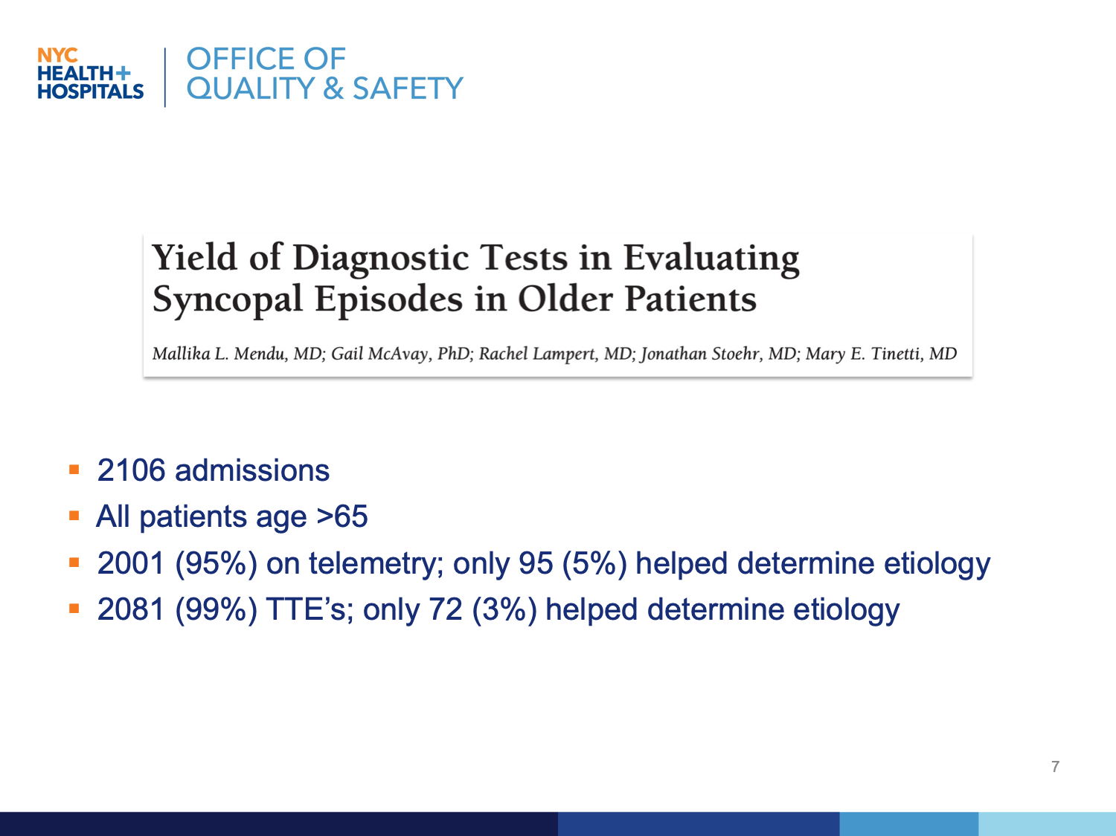
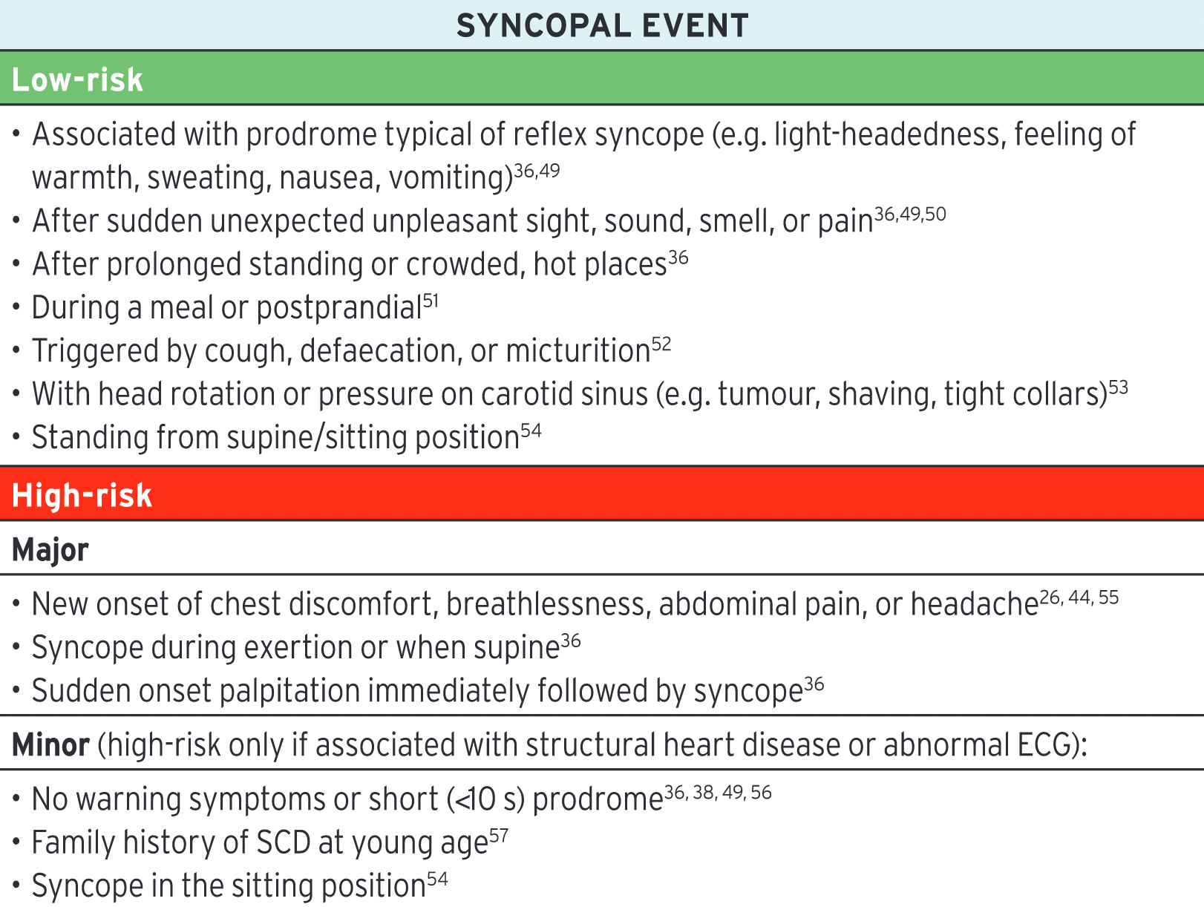
Low/High Risk Features

Slide 17
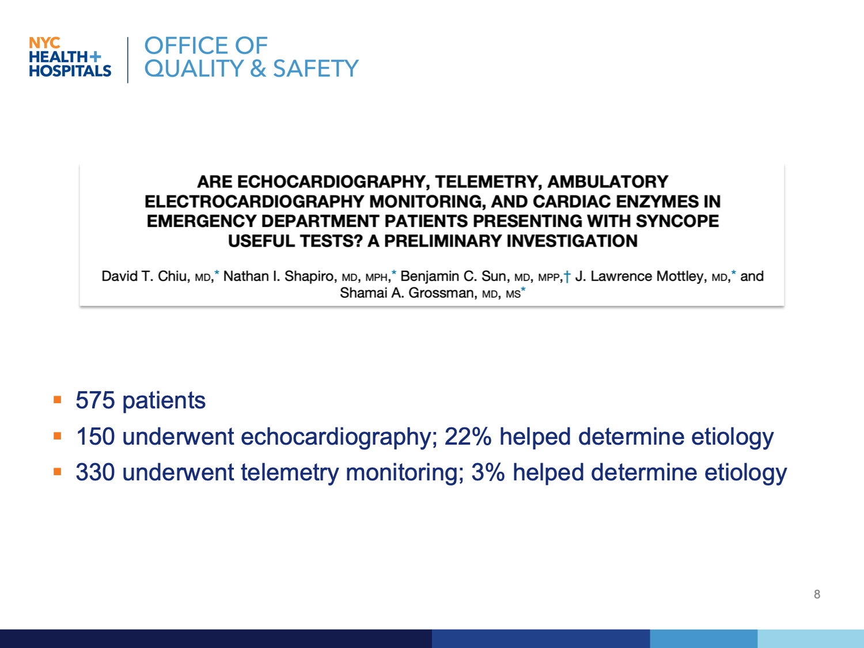

Slide 18
Agenda
Background
Diagnostic Work-up
Low Value Evaluation
High Risk Features
Care Standardization

Slide 19
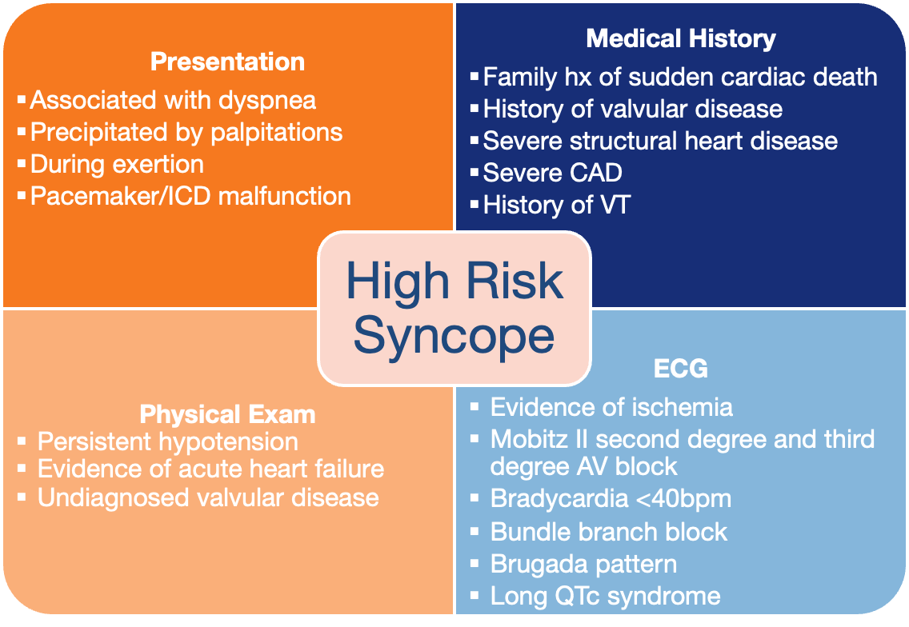

Slide 20
When is Telemetry Appropriate?
History: precipitated by palpitations, during exertion, history of VT, history or evidence of arrhythmia
Abnormal ECG:
  ECG changes consistent with acute ischemia
  Mobitz II second- and third-degree AV block
  Bradycardia
  Sustained and non-sustained VT
  Brugada pattern
  Bi-fascicular block
  Long QTc

Slide 21
When is a TTE Appropriate?
High suspicion of valvular disease
High suspicion of structural heart disease
High suspicion of obstructive cardiomyopathy
High suspicion of congestive heart failure

Slide 22
Agenda
Background
Diagnostic Work-up
Low Value Evaluation
High Risk Features
Care Standardization

Slide 23
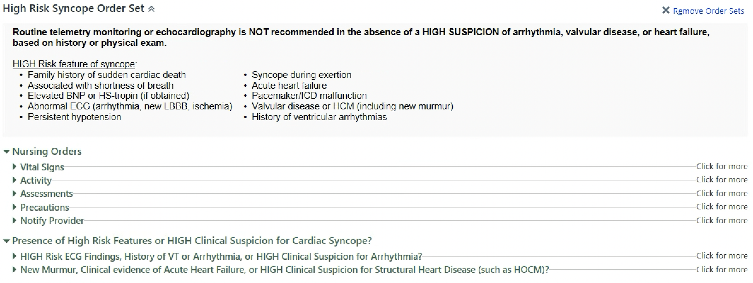
High Risk Syncope Order Set

Slide 24
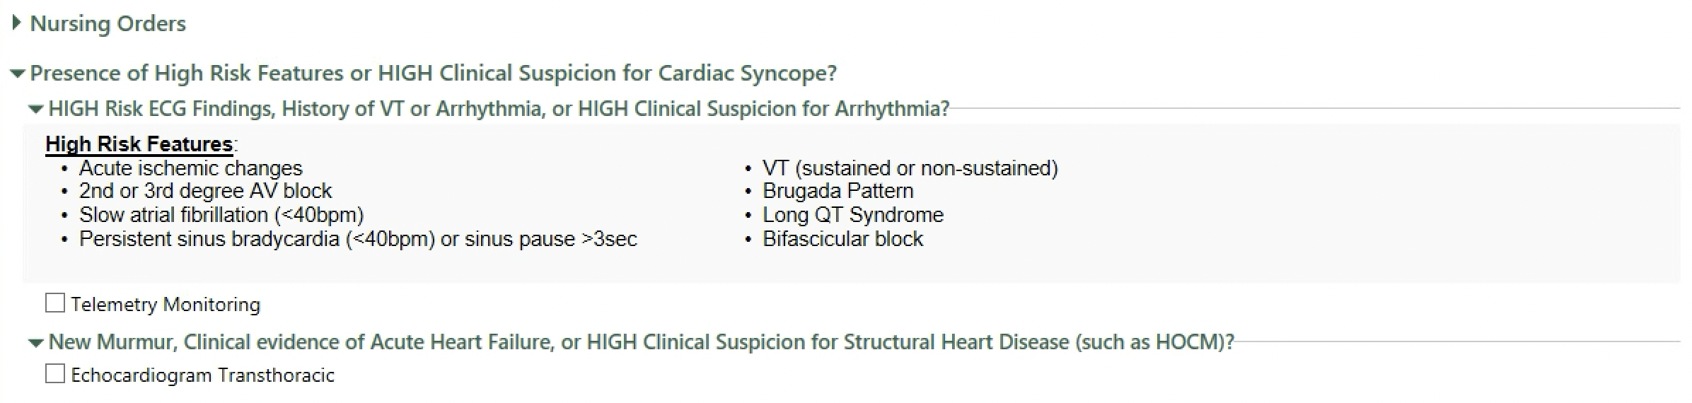
High Risk Syncope Order Set

Slide 25
Act SMART with Syncope!
Look for clues in the clinical history, vitals (orthostatics), physical exam, and ECG that suggest a cardiac etiology.
Symptoms sound cardiac?
Measured orthostatics?
Abnormal physical exam?
Rhythm is concerning?
Telemetry for ischemia or arrhythmia
TTE for heart failure, valvular, or structural disease

