Slide 1
A High Value Approach to
Community Acquired Pneumonia

Slide 2
Definition
Community Acquired Pneumonia: acute infection of the pulmonary parenchyma acquired in the community

Slide 3
Definition
Community Acquired Pneumonia: acute infection of the pulmonary parenchyma acquired in the community
Hospital-Acquired Pneumonia: pneumonia that occurs >48 hours after admission to the hospital

Slide 4
Definition
Community Acquired Pneumonia: acute infection of the pulmonary parenchyma acquired in the community
Hospital-Acquired Pneumonia: pneumonia that occurs >48 hours after admission to the hospital
Ventilator-Associated Pneumonia: pneumonia that occurs >48 hours after endotracheal intubation

Slide 5
Definition
Community Acquired Pneumonia: acute infection of the pulmonary parenchyma acquired in the community
Hospital-Acquired Pneumonia: pneumonia that occurs >48 hours after admission to the hospital
Ventilator-Associated Pneumonia: pneumonia that occurs >48 hours after endotracheal intubation
Health Care Associated Pneumonia

Slide 6
Clinical Severity
Septic shock, OR
Respiratory failure requiring mechanical ventilation, OR
Three of the following:
RR >30
Multi-lobar infiltrates
Confusion
BUN >20
WBC <4k
Platelets <100K
T <36
Hypotension

Slide 7
Risk Stratification (MRSA)
Hospitalization within 90 days AND received IV antibiotics
Risk factors for MRSA Infection

Slide 8
Risk Stratification (MRSA)
Hospitalization within 90 days AND received IV antibiotics
Risk factors for MRSA infection
OR
History of MRSA infection

Slide 9
Risk Stratification (Pseudomonas)
Hospitalization within 90 days AND received IV antibiotics
Risk factors for Pseudomonal Infection
OR
History of Pseudomonal infection
OR
Structural lung disease

Slide 10
Risk Stratification
Hospitalization within 90 days AND received IV antibiotics
Risk factors for MRSA or Pseudomonal Infection
OR
History of MRSA or Pseudomonas infection
OR
Structural lung disease
(For Pseudomonas only)
For aspiration pneumonia, anaerobic coverage is not required in the absence of suspected empyema or lung abscess.

Slide 11
Non-Severe CAP
Non-severe CAP
Penicillin Allergy?
None
Severe
None or Mild
Ampicilin/Sulbactam
+
Azithromycin
Levofloxacin
Ceftriaxone
+
Azithromycin

Slide 12
Non-Severe CAP
Non-severe CAP
Penicillin Allergy?
None
Severe
None or Mild
Ampicilin/Sulbactam
+
Azithromycin
Levofloxacin
Ceftriaxone
+
Azithromycin
Obtain sputum culture and blood cultures if patient was hospitalized within 90 days.
Begin empiric treatment if a patient has recently had isolation of MRSA or Pseudomonas.

Slide 13
Severe CAP
Severe CAP
Risk factors for Pseudomas? infection?
No
Yes
Penicillin allergy?
Penicillin allergy?
No
Yes
No
Severe
Ceftriaxone
+
Azithromycin
Aztreonam
+
Levofloxacin
Cefepime or Piperacillin/tazobactam + Azithromycin
Mild
Levofloxacin + Aztreonam
Alternative: Vancomycin + Aztreonam + Azithromycin
Cefepime + Azithromycin

Slide 14
Severe CAP
Severe CAP
Risk factors for Pseudomas? infection?
If the patient has risk factors for MRSA infection, add Vancomycin.
No
Yes
Penicillin allergy?
Penicillin allergy?
No
Yes
No
Severe
Ceftriaxone
+
Azithromycin
Aztreonam
+
Levofloxacin
Cefepime or Piperacillin/tazobactam + Azithromycin
Mild
Levofloxacin + Aztreonam
Alternative: Vancomycin + Aztreonam + Azithromycin
Cefepime + Azithromycin

Slide 15
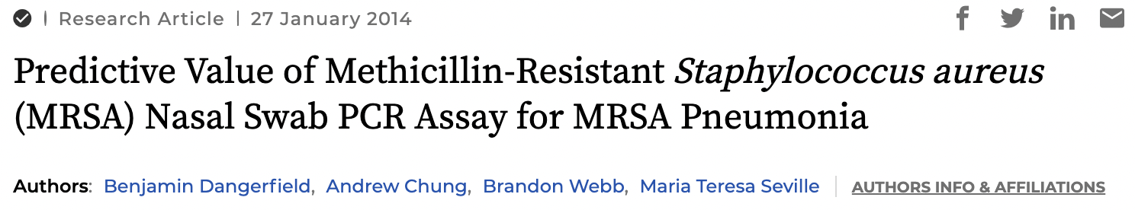
Ruling Out MRSA
IDSA recommends obtaining an MRSA Nasal PCR if empirically treating with Vancomycin.
A negative nasal PCR has a negative predictive value of 99.2%.

Slide 16
Duration of Treatment
If 24 hours with resolution of abnormal vital signs (temperature, O2 sat, etc) AND tolerating oral diet AND at baseline/normal mentation…
CAP IT AT 5 DAYS!
Confirmed MRSA or Pseudomonal infection should be treated for a minimum of 7 days.

Slide 17
Duration of Treatment
If 24 hours with resolution of abnormal vital signs (temperature, O2 sat, etc) AND tolerating oral diet AND at baseline/normal mentation…
CAP IT AT 5 DAYS!
Confirmed MRSA or Pseudomonal infection should be treated for a minimum of 7 days.
This recommendation does NOT apply to patients with complications including an empyema or lung abscess.

Slide 18
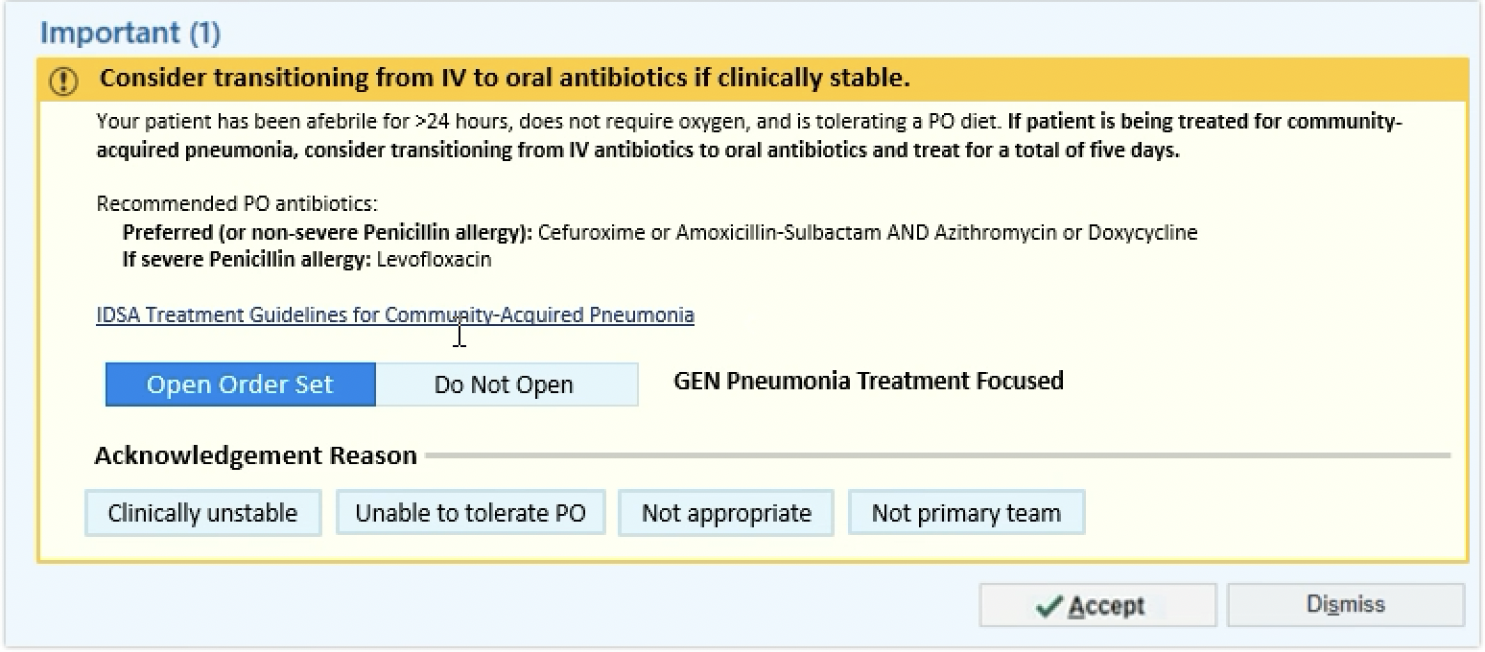
Upcoming Epic Interventions
IV to PO Antibiotics BPA - GO LIVE MAY 31st

Slide 19
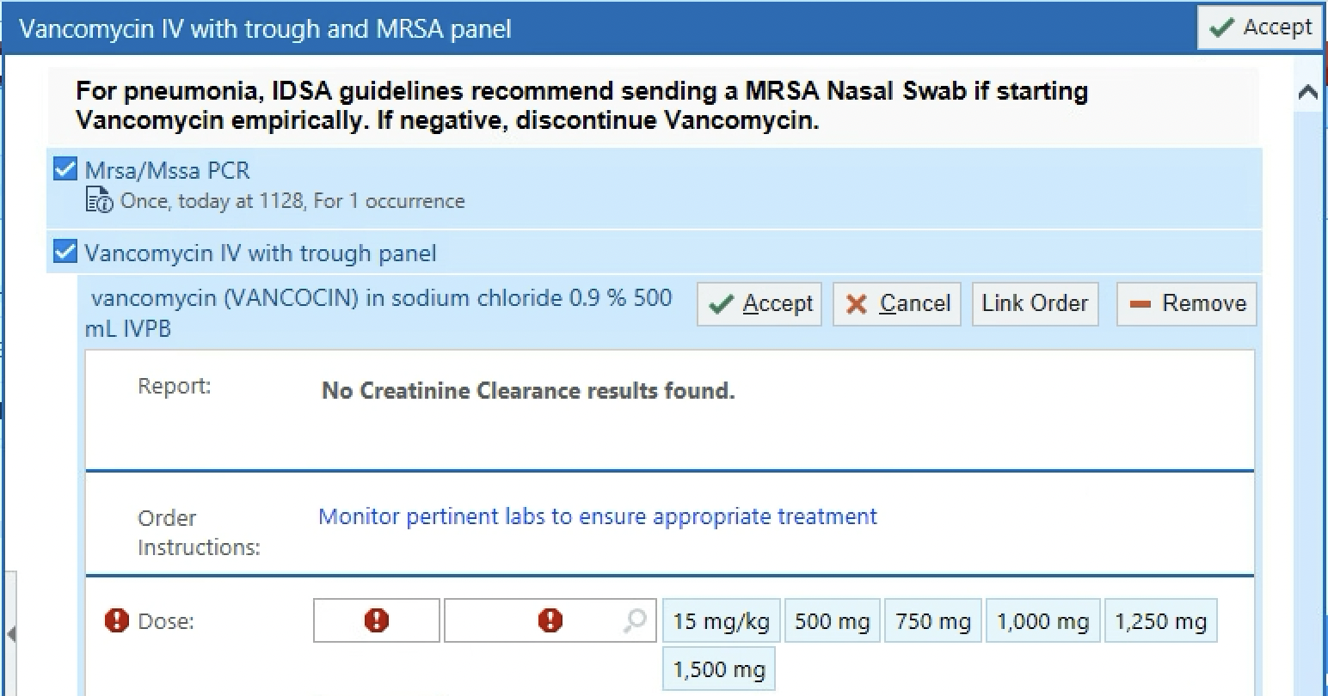
Upcoming Epic Interventions
Vancomycin + MRSA Nasal PCR Panel - COMING SOON

Slide 20
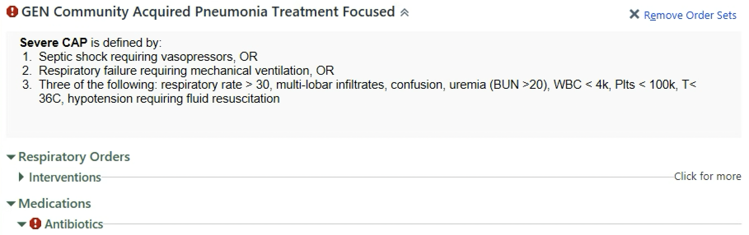
Upcoming Epic Interventions
Community Acquired Pneumonia Order Set - COMING SOON

Slide 21
Thank you!

